Slide 1
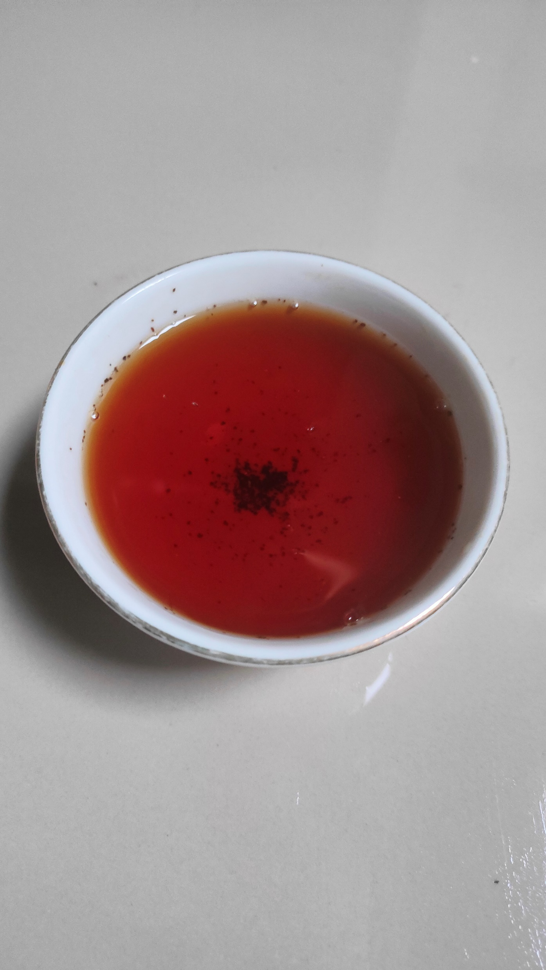
ADVANTAGES OF CTC TEA
CTC tea from Indonesia has several advantages that can be used as selling points compared to CTC tea from competitor countries such as India, Kenya, and Sri Lanka. Here are some of the main advantages:

Slide 2

1
Distinctive Quality and Taste
Characteristics of Tea - CTC tea from Indonesia is known to have a more subtle flavor and mild aroma compared to tea from other countries such as Kenya which tends to have a very strong and concentrated flavor. This appeals to consumers who like tea with a more balanced and less bitter flavor profile.
Flexibility in Blending - Due to its balanced flavor, Indonesian CTC tea is often used in blending to create a complex tea blend without dominating the flavors of other teas.

Slide 3

2
Environmental Excellence and Quality
Environmental Certification - Many tea plantations in Indonesia have obtained environmental certification such as **ISO 14001**, which guarantees that the production process is environmentally friendly. This is attractive to importers in countries that care about sustainability and environmental standards.
Climate Diversity - Indonesia's tropical climate and volcanic soil give a uniqueness to the tea plants produced. This condition allows tea to grow all year round, unlike some competitor countries that have limited harvest seasons.

Slide 4

3
Competitive Price
Relatively Low Production Costs - Compared to countries like Sri Lanka and India, the cost of producing tea in Indonesia tends to be lower due to cheaper labor costs. This allows exporters to offer more competitive prices in the global market without sacrificing quality.
Transportation Savings to Southeast Asian Markets - Indonesia's strategic geographical location allows for savings in shipping costs to countries in Southeast Asia and the Middle East, which are the main markets for CTC tea. This provides an advantage in terms of distribution efficiency.

Slide 5

4
Product Diversification
Tea Varieties - In addition to CTC black tea, Indonesia is also known for its production of green tea and other types of tea, which gives exporters the flexibility to offer a wider product portfolio to importers. This allows importers to purchase a variety of products from a single source, which is often more efficient.
Industrial and Consumer Quality Tea - Indonesia is able to provide tea in various grades to meet the needs of both industry (for blending) and direct consumers. This provides more advantages in meeting the demand from various market segments.

Slide 6

5
Competitive Packaging and Certification
Practical Packaging - CTC tea products from Indonesia are often packed in **large papersacks (52Kg)** which are efficient for bulk shipping and highly sought after by large importers.
Halal Certification - As a Muslim-majority country, Indonesia offers tea products with **Halal certification**. This provides a special appeal in the Middle East, North Africa and South Asia markets, where consumers pay attention to halal certification.

Slide 7

6
Sustainability in Production
Year-round Production - Unlike some other countries that only have specific harvest seasons, Indonesia can produce tea all year round. This ensures continuity of supply and flexibility in meeting demand without seasonal limitations.
Excellence in Organic Markets - While the CTC Indonesia tea you produce is non-organic, many plantations in Indonesia also offer organic tea, allowing you to target a wider market if you are considering an organic product one day.

Slide 8

7
Cultural Diversity and Export Experience
Strong Export Experience - As one of the world's leading tea exporting countries, Indonesia has the infrastructure and logistics network to support the export of tea products to various parts of the world, ensuring supply reliability and delivery accuracy.
Reputation in Asian and Middle Eastern Markets - Indonesia has a good reputation in markets such as Southeast Asia, South Asia and the Middle East, which have been importing tea from Indonesia for a long time, giving it an edge in terms of trust and trade relations.

Slide 9
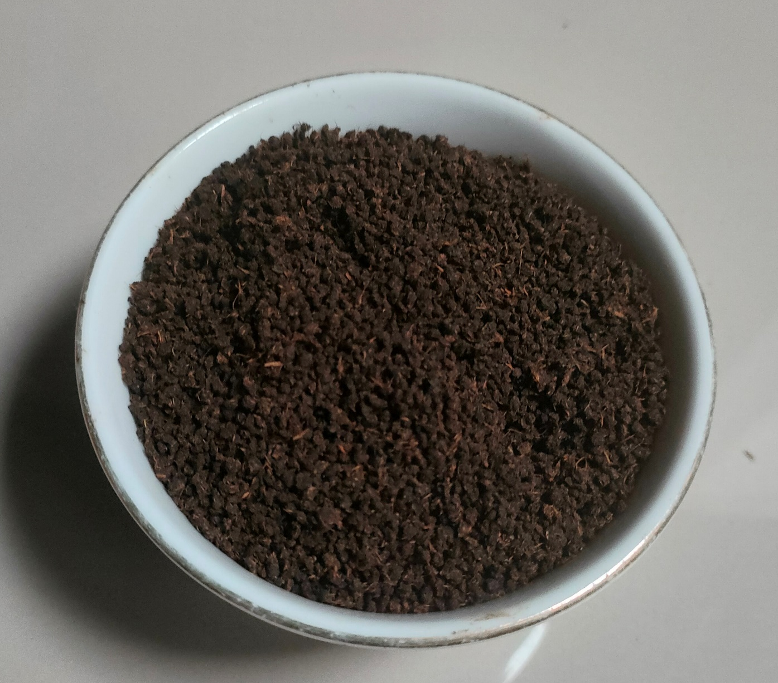
Conclusion
The advantages of Indonesian CTC tea lie in its finer flavor quality, competitive production cost, year-round production sustainability, as well as environmental and Halal certification. In addition, the large and efficient packaging makes it attractive to large importers, especially in key markets such as Asia, the Middle East, and Africa.

